Slide 1
Canva

Slide 2
Training
Line of Discussion
Overview
How to use Canva?
Q & A

Slide 3
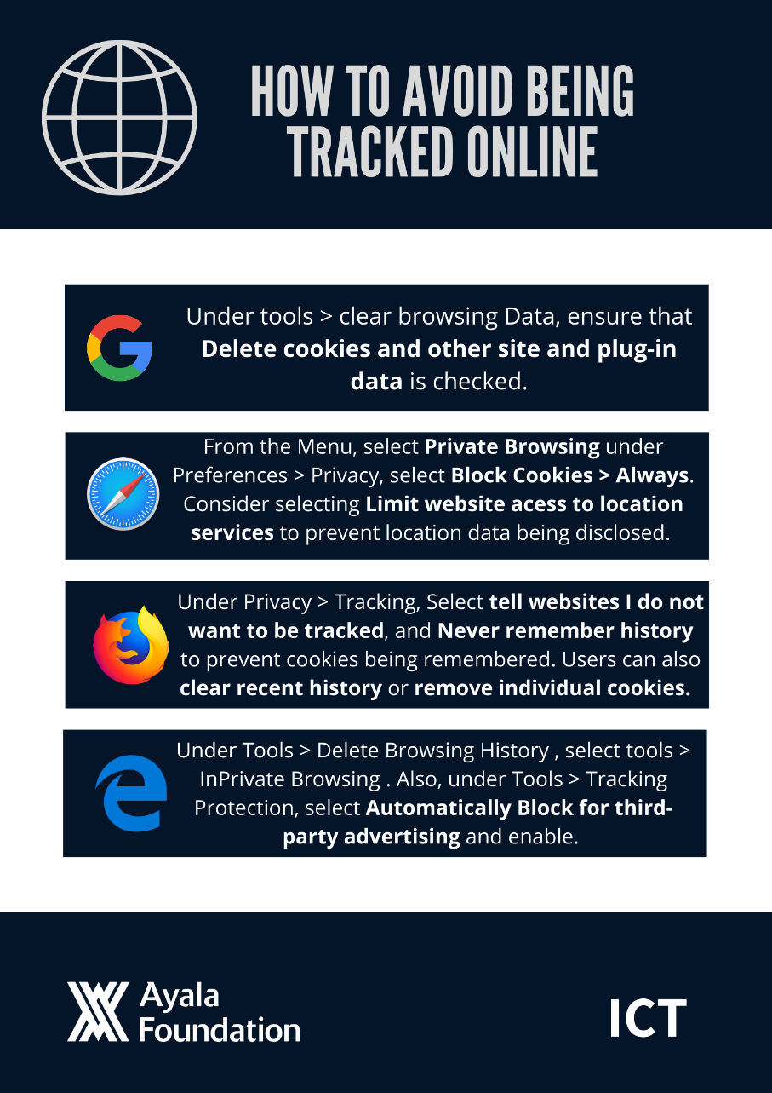
Training
WHAT IS CANVA?
Notes:
Canva is a graphic design platform that allows users to create social media graphics, presentations, posters and other visual content. It is available on web and mobile, and integrates millions of images, fonts, templates, and illustrations.

Slide 4
Training
What’s in it for me?
HR
SOCDEV
CORP
SERVICES
ICT
COMMS
ACD
OP
FINANCE

Slide 5
Training
FEATURES OF CANVA
Notes:
Variety of images, stock photographs, vectors, and illustrations that you can drag and drop to your designs.
Free icons, shapes, and elements.
Great selection of fonts that are perfect for your designs.

Slide 6
Training
HOW TO USE CANVA?
Bring your ideas
to life with

Slide 7
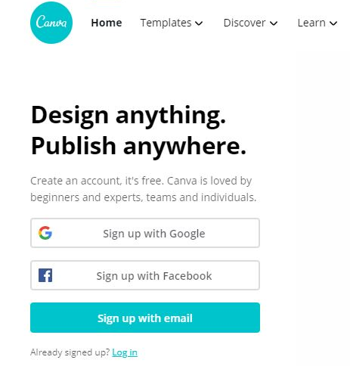
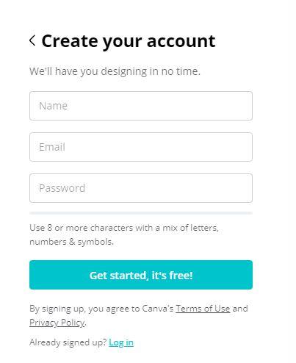
1
Training
Sign up for a free account at canva.com
Tricia Serrano
patriciaellaineserrano@gmail.com
Note:
ICT do not recommend using work AFI email when signing up to non AFI essential websites due to the following reasons; Privacy, Password and Security, and Spam. But inevitably, your work and personal email accounts serve different purposes and using them separately is probably your safest option.
**************

Slide 8
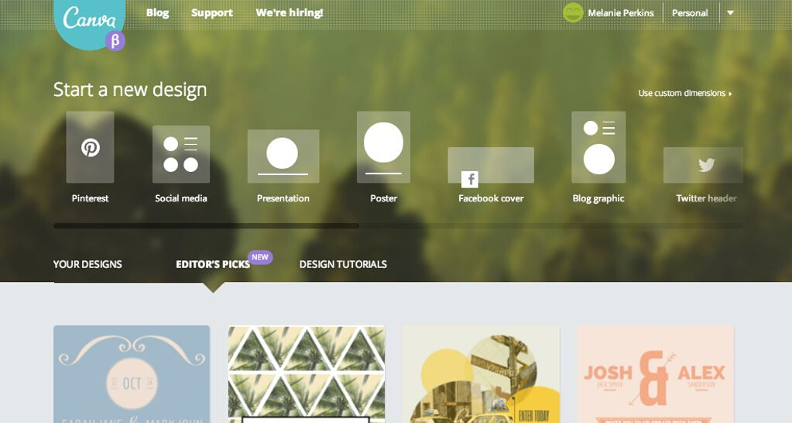
2
To get started choose a 'Design Type', such as 'Presentation’, ‘Poster’ or 'Blog graphic'

Slide 9
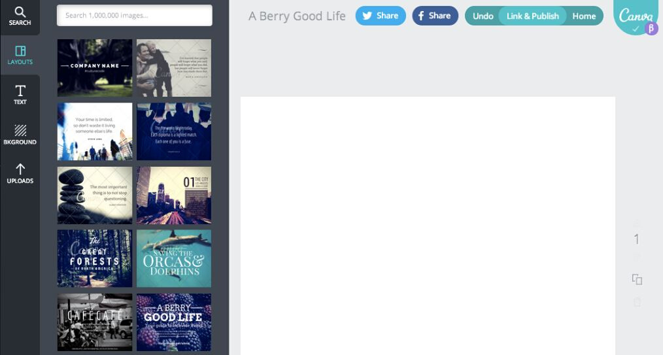
3
This is the Canva editor, here you can design your graphic. To start with, choose a Layout on the left side and drag it onto your page.

Slide 10
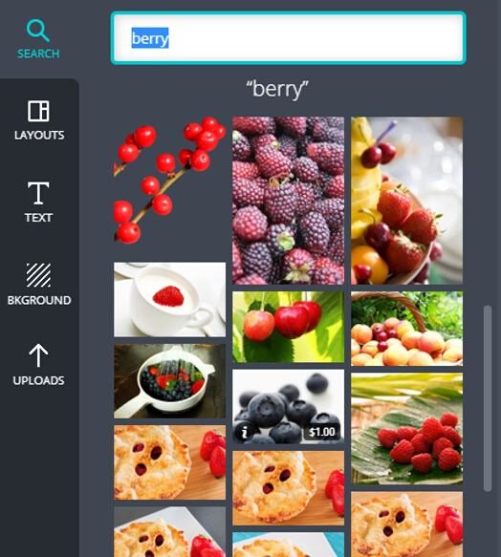
4
Select the image that you like, drag it directly onto your frames and it will snap into place.
ICT
Information and Communications
Technology

Slide 11
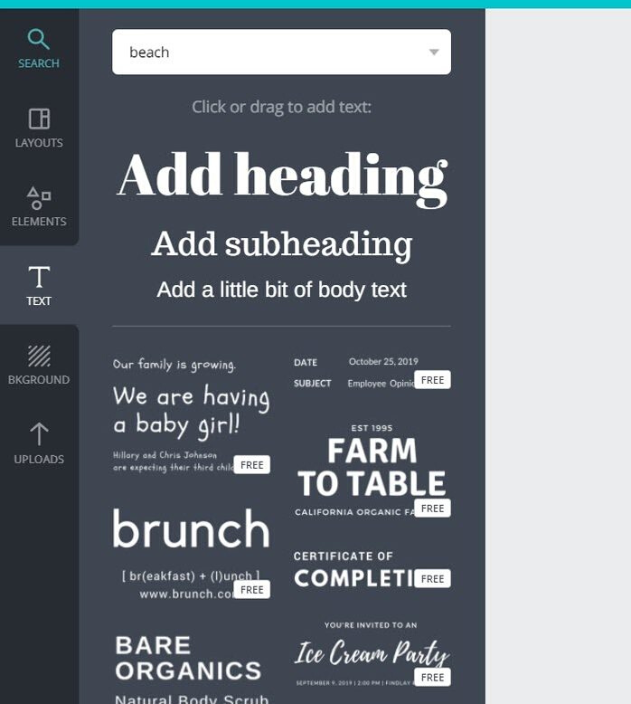
5
Add text and select appropriate graphic elements.

Slide 12
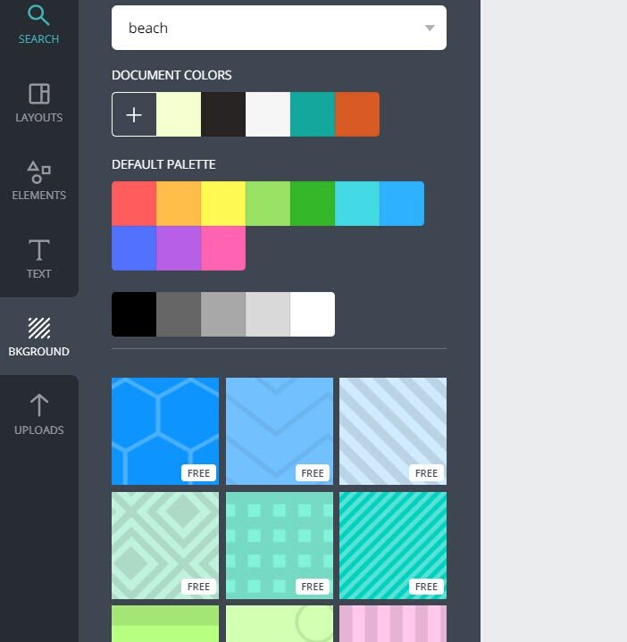
6
If you want a plain or a pattern background, click on the backgrounds tab and change the color.

Slide 13
7
You are now ready to share and download your design.

Slide 14
Training
LIVE DEMO
www.canva.com

Slide 15
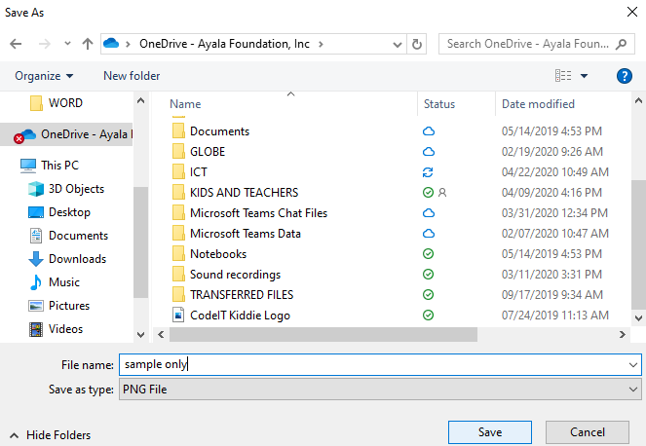
Training
DOWNLOADING YOUR DESIGNS

Slide 16
Training
ANY QUESTIONS?
Q & A

Slide 17
Training
THANK YOU!
For concerns, please feel free to email us at
serrano.po@ayalafoundation.org
masanque.jp@ayalafoundation.org

