Slide 1
❶
Check your audio and video settings prior to the start of the session
❷
Use Q&A for your questions/ clarifications
❸
Answer the feedback form that will be given after the session
Notes:
Online Etiquette in using Microsoft Teams

Slide 2
Google Classroom
ICT
INFORMATION AND COMMUNICATIONS
TECHNOLOGY

Slide 3
Line of Discussion
Overview of G Suite for Education
What is Google Classroom
Features of Google Classroom
Integration with Google Forms

Slide 4
AN OVERVIEW
Notes:
Canva is a graphic design platform that allows users to create social media graphics, presentations, posters and other visual content. It is available on web and mobile, and integrates millions of images, fonts, templates, and illustrations.

Slide 5
is a suite of tools that can help increase opportunities for critical thinking, communication, collaboration, and creativity, all while supporting the learning objectives that one have for his/her students.
is a suite of free Google tools and services that are tailored for schools and homeschools. It is available globally to all educational institutions that qualify.
WHAT IS
FOR
EDUCATION
Notes:
Canva is a graphic design platform that allows users to create social media graphics, presentations, posters and other visual content. It is available on web and mobile, and integrates millions of images, fonts, templates, and illustrations.

Slide 6
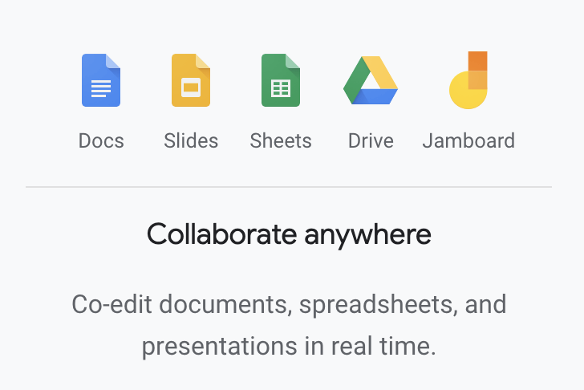
Excel
OneDrive
Powerpoint
Word
Whiteboard

Slide 7
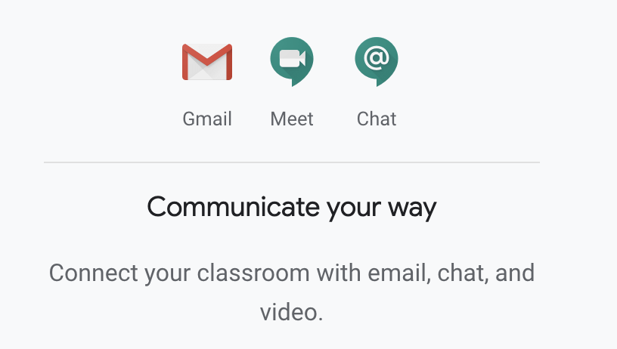
Teams
Outlook

Slide 8
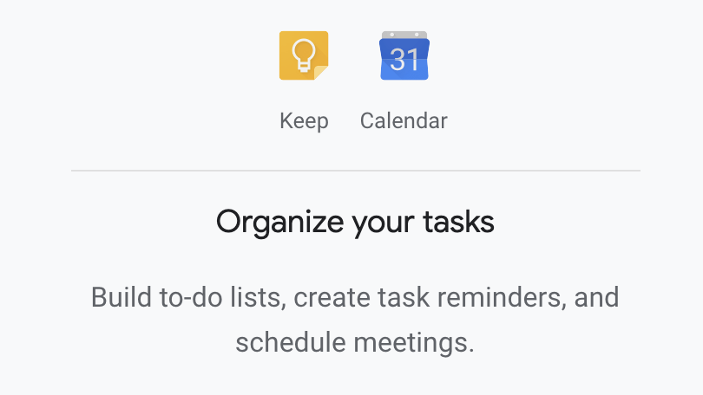
Outlook
OneNote

Slide 9
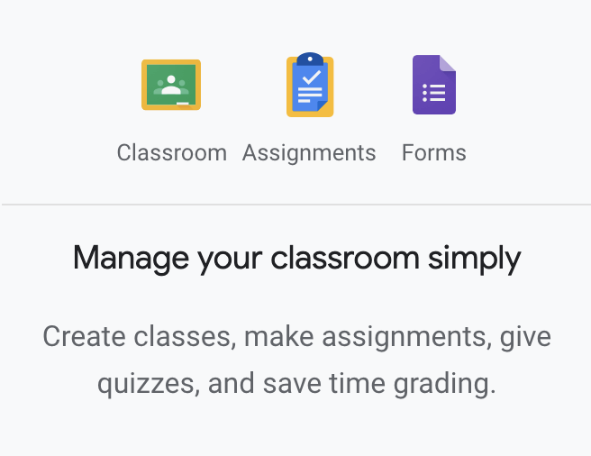
Forms

Slide 10
Google Classroom
ICT
INFORMATION AND COMMUNICATIONS
TECHNOLOGY

Slide 11
Google Classroom is a streamlined, easy-to-use tool that helps teachers manage coursework.
With Classroom, educators can create classes, distribute assignments, grade and send feedback, and see everything in one place.
ICT
Information and Communications
Technology
Notes:
Canva is a graphic design platform that allows users to create social media graphics, presentations, posters and other visual content. It is available on web and mobile, and integrates millions of images, fonts, templates, and illustrations.

Slide 12
Who can use Google Classroom?
Anyone!
It is included as a free service for anyone with a personal Google account, and it's also free for organizations using G Suite for Education or G Suite for Nonprofits.

Slide 13
Benefits of Using Google Classroom?
01
Make teaching more productive, collaborative, and meaningful
02
Tackle administrative tasks more efficiently
03
The best in learning management at no cost
04
Work anywhere, anytime, and on any device
05
More time for richer feedback

Slide 14
Google Classroom Roles
Teachers / Trainers
Students
Parents / Guardians

Slide 15
Features available for teachers
01
Streamline how they manage classes.
02
Digitally organize, distribute, and collect assignments,
course materials, and student work.
03
Communicate with students about their classwork.
04
Give students timely feedback on their assignments and assessments.

Slide 16
Additional features for teachers
Create, view, or delete and manage classes
Add or remove students and invite teachers in their classes.
Manage the overall classroom settings and limitations for students
01
02
03

Slide 17
Features for students
Track classwork and materials.
01
Share resources and interact in the class stream or by email.
02
Submit assignments.
03
Get feedback and grades.
04

Slide 18
Features available for Guardians/Parents
Get an email summary of their student’s work. This summary includes information about missing work, upcoming assignments, and class activity.
Note:
Guardians can’t sign in to Classroom directly. They need to receive email summaries through another account.
This is a G Suite exclusive feature.

Slide 19
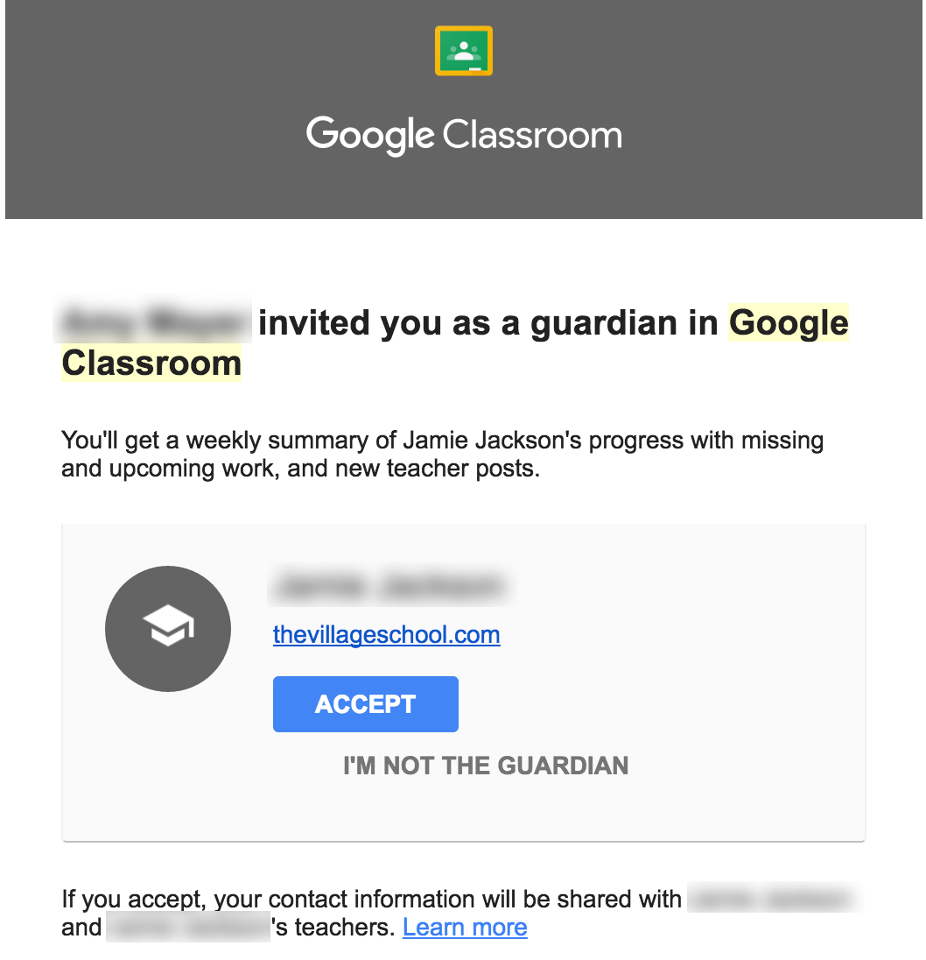
Continuation…
This is what an email invite looks like when received by parents/guardians
*G Suite administrator must turn on this feature to work

Slide 20
Supported Browsers and Devices

Slide 22
Exploring Google Classroom as a Teacher/Trainer

Slide 23
1
How to access Google
Classroom?
Type “classroom.google.com” in your browser
Or go to google.com.ph and
click the icon located at the upper right corner then look for “Classroom”

Slide 24
2
How to set up your class in Google Classroom?
Click the + sign located at the upper right corner of the Classes page.
Choose “Create class”.
A notice pop-up will appear. Make sure you read it (and check the checkbox) before you click “continue”
Type in the class information including the Class name, Section, Subject and Room. Then click “Create”

Slide 25
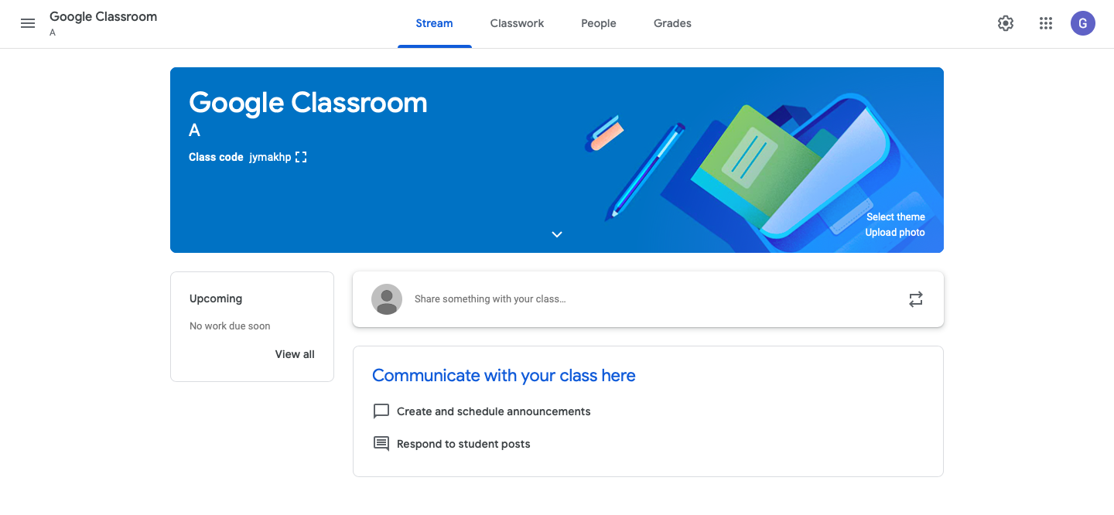
2
How to set up your class in Google Classroom?
Use the classcode to let your students enroll in your class
You can see and manage the students (as well as teachers) enrolled here.
All your posts, assignments, materials and tasks can be seen here (just like your Facebook )
You can post your announcements or messages to the class here
You can create, post and organize assignments, quizzes, questions, materials in this section.

Slide 26
3
How to add / invite students in your class?
How to add students into your Google Classroom?
Email invite
Through the “People” section, you can invite students through email
Class Code
Students enter the class code in the “Join a class”. Each code is unique to every class.
Invite Link
You can generate an invite link and send it though any messaging applications.
Note: Students can unenroll themselves from classes. If they unenroll, their grades are removed.

Slide 27
3
How to add / invite students in your class?

Slide 28
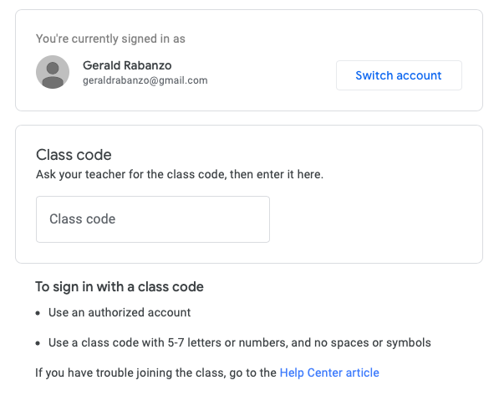
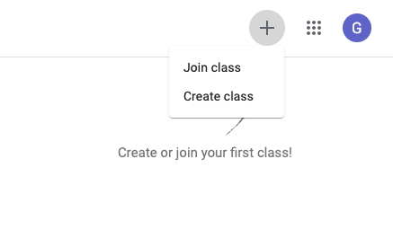
Joining using class code (students’ perspective)
Enter the class code given by the teacher
Click the + sign at the upper right corner of the screen.
Choose “Join class”

Slide 29
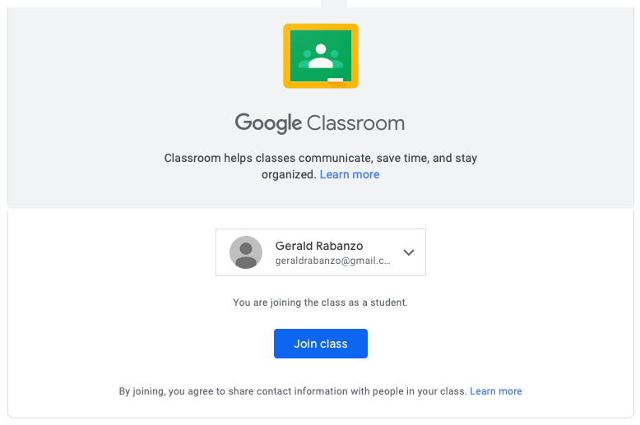
Joining by clicking the invite link (students’ perspective)
Choose the account you want to use in joining the class and then click “Join class”.

Slide 30
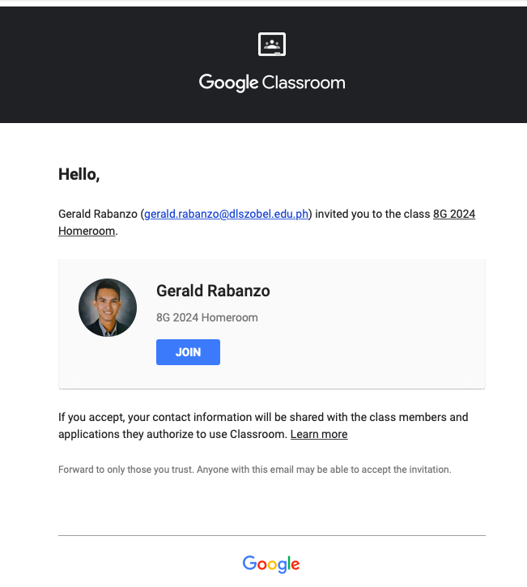
Joining a class from an email invite (students’ perspective)
Student’s email
Class Name
Go to your email and check and any email that contains “Class invitation”.
Teacher’s Name
Class Name

Slide 31
What is a Stream?
Stream in Google Classroom is a hub where all the posts, announcements, assignments, tasks and etc are displayed in a chronological order. The oldest at the bottom, newest at the top.

Slide 32
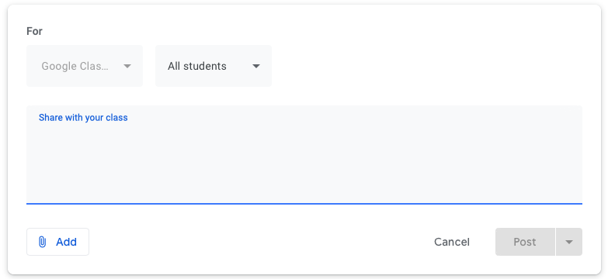
4
How to post in the stream?
Hover your cursor here and click
You can also select specific students for your message.
Type your announcement or message to the class here.
Then, this will show.
You can also add attachments

Slide 33
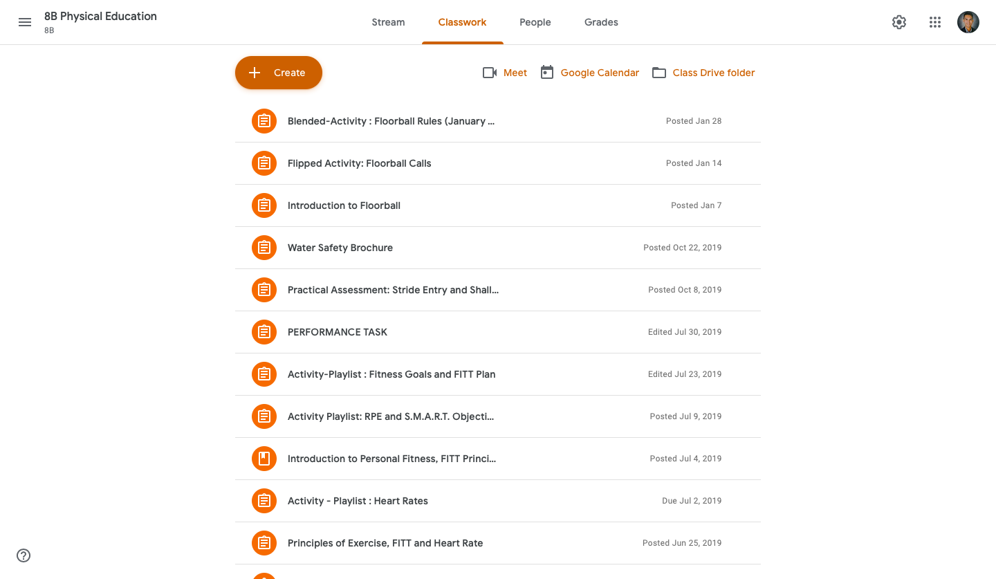
5
Classwork page

Slide 34
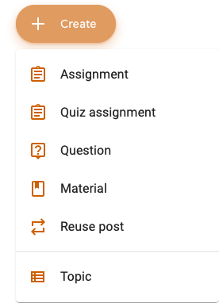
What can we add in the Classwork?
Allows the teacher to post an assignment where students can attach files and send it on or before a scheduled deadline.
Allows the teacher to create a quiz that is integrated with Google Forms
Allows the teacher to post questions with short answers
Allows the teacher to post materials for the class such as documents, images, videos, PowerPoint presentations for students references.
Allows the teacher to reuse and repost a material, assignment, questions or posts from other class.
Allows the teacher to create sections in the classwork for easy sorting of related posts.

Slide 35
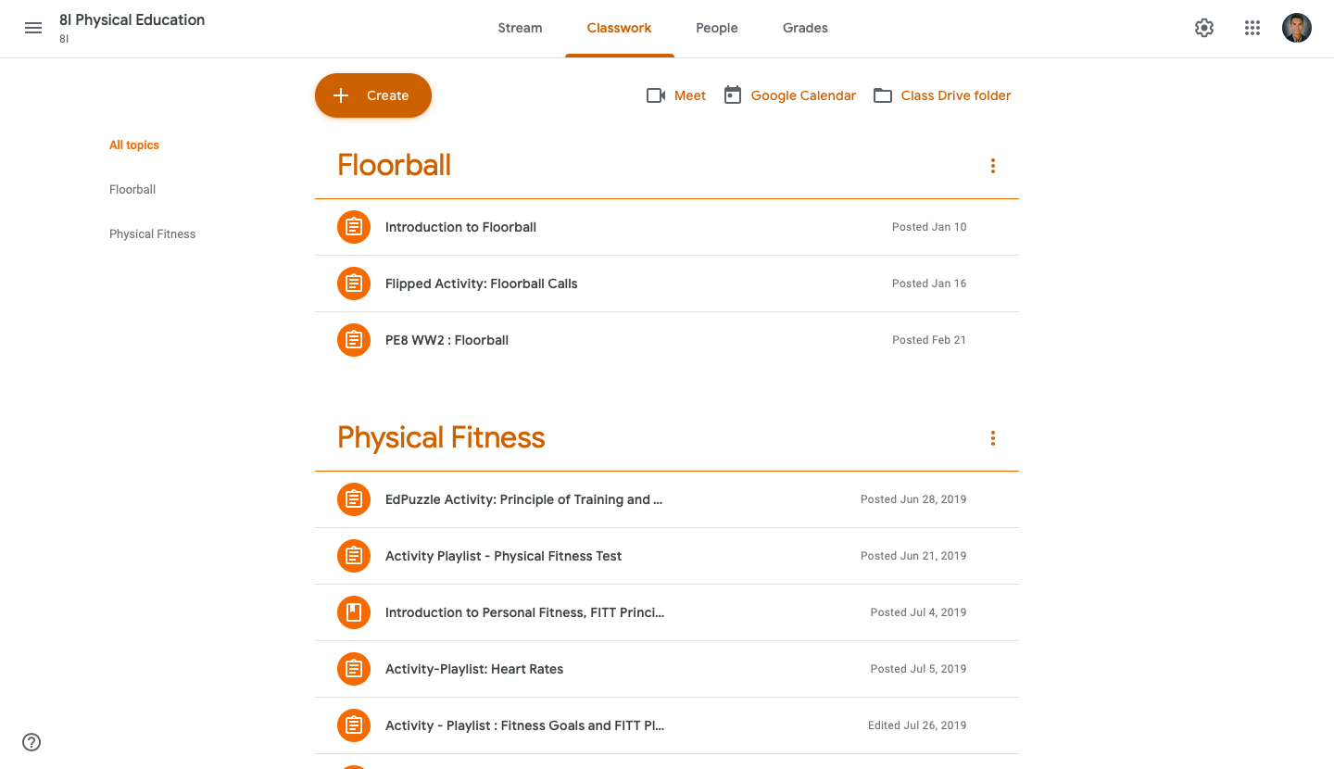
Creating Topics
1. Click "+ Create" button
2. Choose "Topic"
3. Type the desired label for the topic and then click "Add"

Slide 36
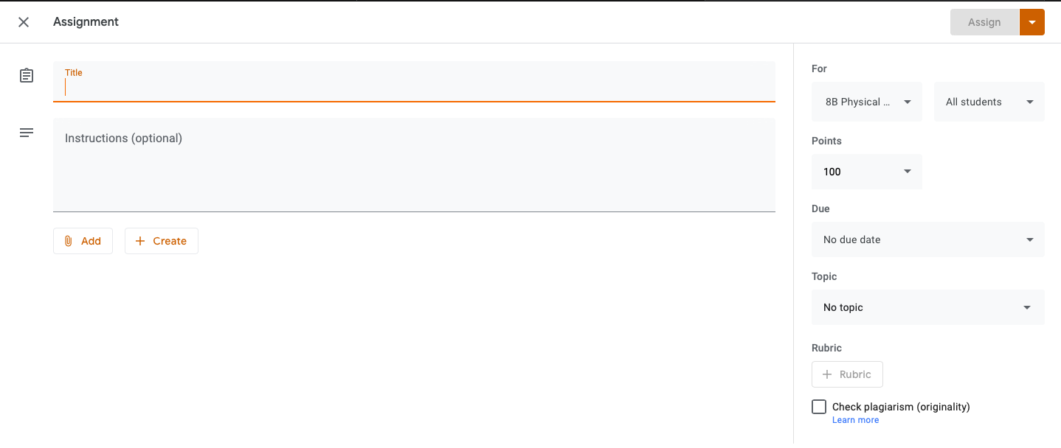
Adding assignments
Type your assignment title here
Type your instructions here
Choose any attachments you want to upload here (images, videos, documents, links)

Slide 37
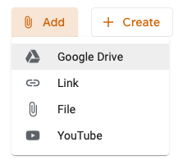
Adding Materials
Type your material title/label here
Type your descriptions here
Choose where you will get your attachment

Slide 38
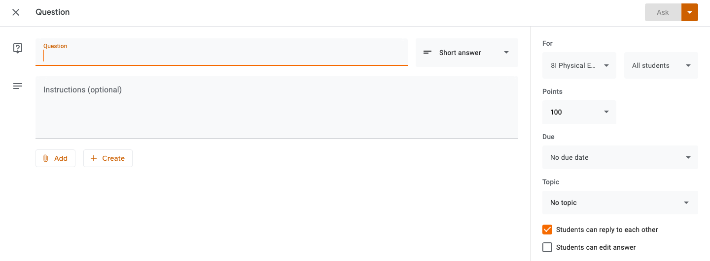
Adding Questions
Type your question here
You can put optional instructions here
Check or uncheck if you want to toggle on or off these features

Slide 39
Reuse Post

Slide 40
6
How to complete assignment (Students’ perspective)
This is where students’ upload their work
Only your teacher will see your comment here
Your classmates will see anything you write here
Follow the instructions carefully
DON’T FORGET TO CLICK ‘MARK AS DONE’ SO YOUR TEACHER WILL BE NOTIFIED!

Slide 41
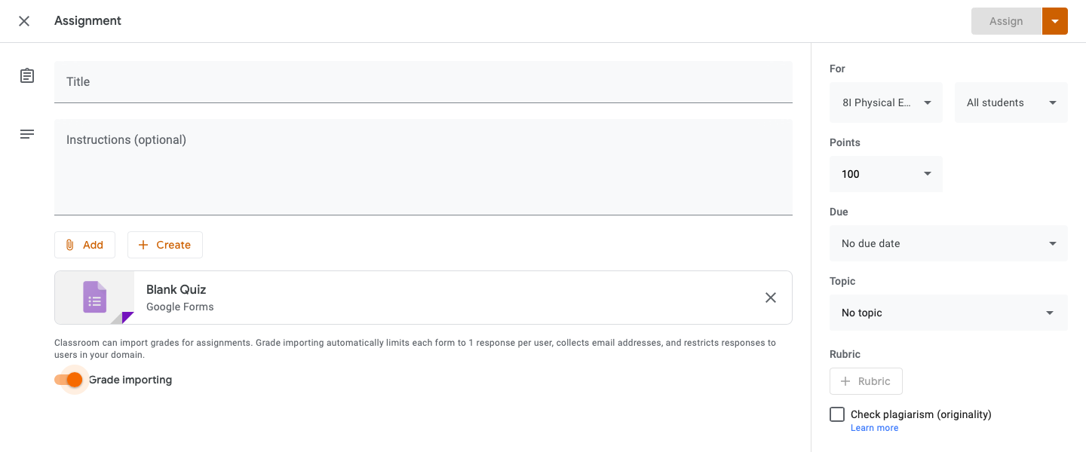
7
Integration with Google Forms
Another Google application, the Google Forms, can be integrated and assigned to the class
Continuation…

Slide 42
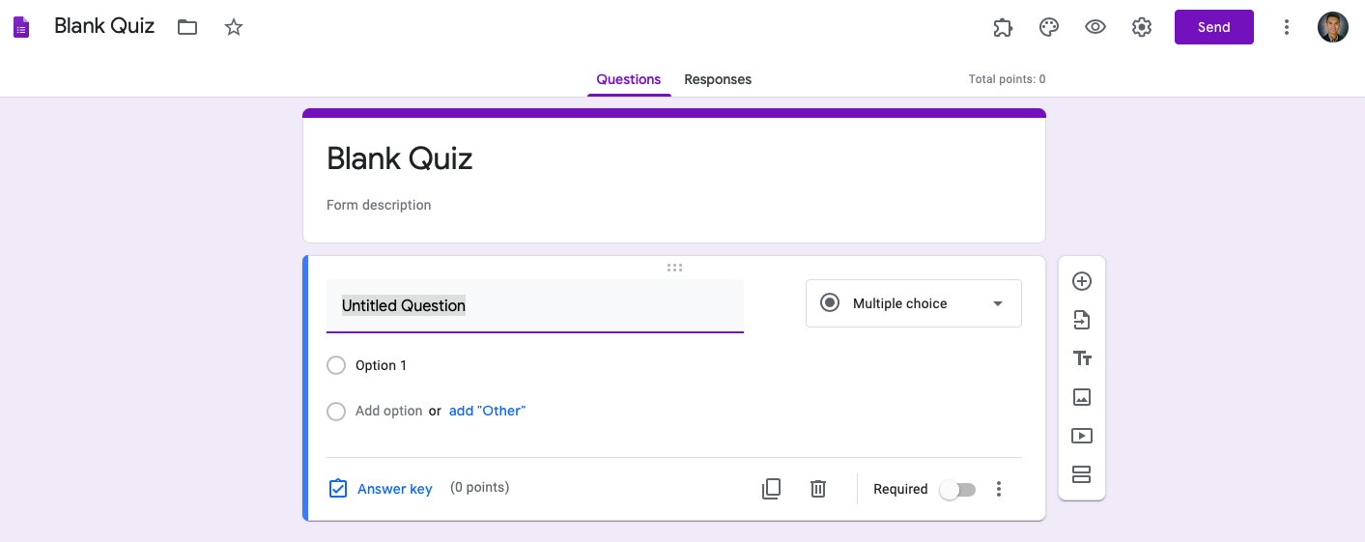
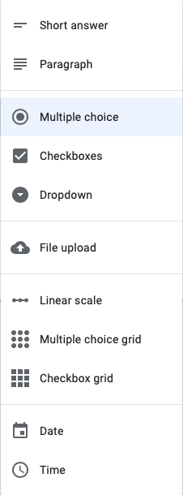
7
Integration with Google Forms
Continuation…

Slide 43
7
Integration with Google Forms
Add question
Import questions
Add title and description
Add image
Add video
Add section
Continuation…

Slide 44
8
Managing classroom settings

Slide 45
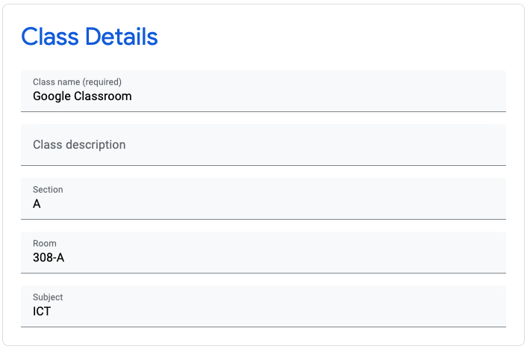
8
Managing classroom settings

Slide 46
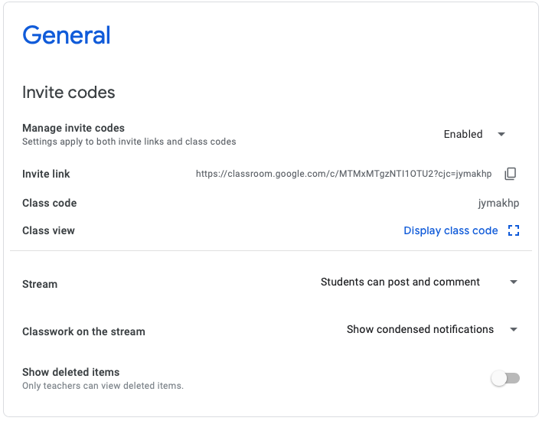
8
Managing classroom settings
Enable/Disable, as well as, reset the invite links, class codes that you sent to your students
Manage who can post and comment in the stream

Slide 47
9
Deleting a Class
Click the icon located at the top left corner of the page.
Choose a class and click the 3-dot icon on the top right of the class thumbnail. Choose “Archive”.
Click again the icon and go to “Archived classes”
Choose a class and click the 3-dot icon on the top right of the class thumbnail. Choose “Delete”.

Slide 48
Enrichment Activities

Slide 49
Activity 1. Let us begin using Classroom
Log in using your Google email account.
1
Then you may start creating a Google Classroom.
2
Write the class name based on your subject major and your last name. E.g. history_villarey
3
Change the theme in relation to the subject. It will be better if you upload a photo.
4

Slide 50
Activity 2. Let us invite others to join our class.
Invite at least 4 participants in the breakout to join your class.
1
Give your class codes to your co-participants.
2
Or send them an email to join the class.
3

Slide 51
Activity 3. Let us greet our students.
Send a message to your students via the Stream.
1
Your message must include a greeting, your name, and your favorite color.
2
E.g. Hi! I am Dianne! I enjoy things that are in purplish color.
3

Slide 52
Activity 4. Let us get organized.
Go to your Classwork page.
1
Then create 3 Topics.
2
Make sure that your topics are related to your subject.
3

Slide 53
Activity 5. Let us add resources.
Go to your Classwork page.
1
Add material. Put ”Solar System” as title.
2
Attach a video from Youtube: search “Solar system”.
3

Slide 54
Activity 6. Let us add assignments.
Go to your Classwork page.
1
Create an assignment for your students.
2
Make sure that your assignment topic is related to your subject.
3

Slide 55
Q&A
Portion

