Slide 1
Online Training

Slide 2
Objectives
At the end of the training session, the participants should be able to:
Describe the basic functions
describe the basic features and functionalities of MS Teams
Collaborate with peers
collaborate with peers using the MS Teams chat function;
Create Teams and Channels
create teams and channels that can be used for file sharing and announcements
Create and Join a meeting

Slide 4
Logging in to MS Teams

Slide 5
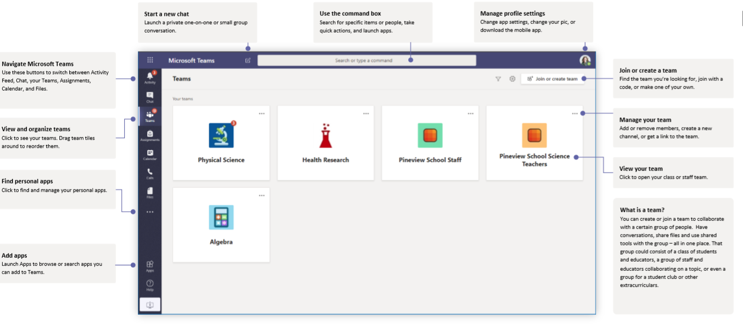
Interface

Slide 6
Start New Chat: One-on-one or small group conversations
Manage Profile Settings: Change app settings, picture or download mobile app
Join or Create a Team: Find a team, join with a code or create your own team.
Navigation Buttons: Use this to navigate between Activity Feed, Chat, Teams, Calendar, and Files

Slide 7
Collaborating using MS Teams Chat

Slide 8
Activity 1
Use the chat function to find your friend and say something nice to them.
Send a screenshot to the chat box once done.

Slide 9
Collaborating using MS Teams Calls

Slide 10
Creating your first Team

Slide 11
Activity 2
Create your own team and add at least one person.
Create a channel and upload one file.

Slide 12
Participating in a Meeting

Slide 13
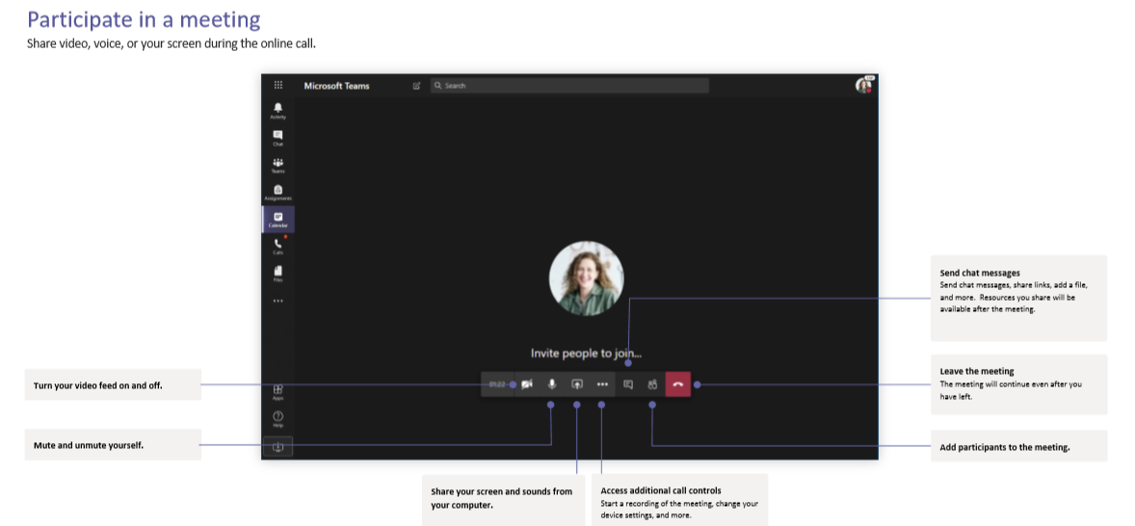

Slide 14
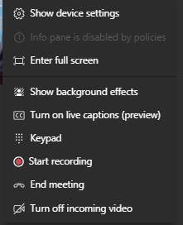
Show or Hide Video
Mute or Unmute
Share Screen
Raise Hand
Chat
Participants
Leave Meeting

Slide 15
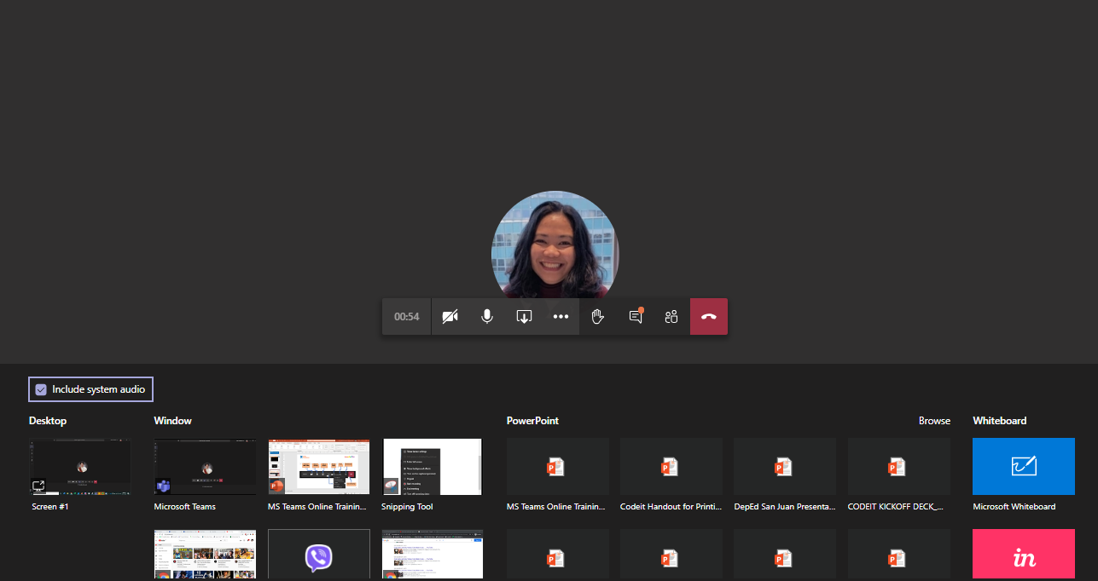
When you click screen share, you have to choose which screen to share.
If you are sharing something with audio, make sure to check the “Include system audio” box.

Slide 16
Activity 3
Share your screen and talk about one of the features of MS Teams and how it will help you.

Slide 17
Question and Answer
If you have any questions, please type it in the chat box or use the raise hand function.

